Slide 1
Eleanor Moody Shepherd Spotlight
Jessica Norment – surge 2020

Slide 2


Montgomery 1960 Team Problem
The goal of the Montgomery 1960 project is to make an engaging game by implementing historic content and experiences with the use of empathy for players.
This is important to me because I believe that it is important to be empathetic about triggering topics and tying in historical context to make this a stimulating experience. There needs to be no bias involved in this project and individuals who can bring this information to a general level of understanding.

Slide 3
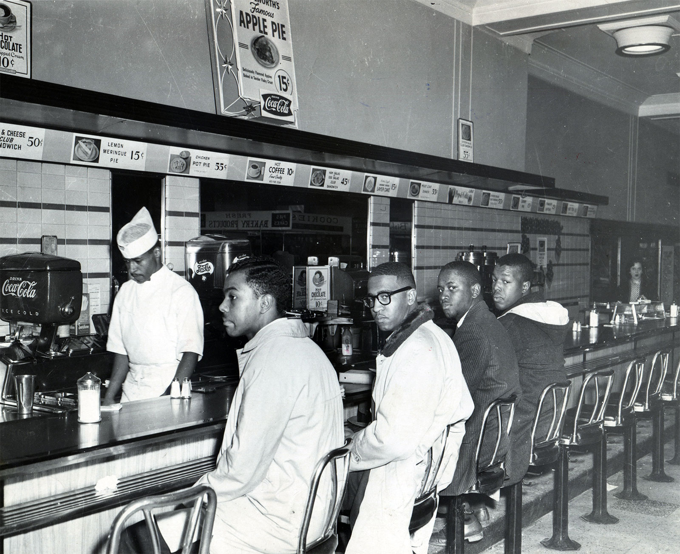
Individual Contributions to project
What I did personally
- Researcher on the history team and collaborated with subgroups (design, production, empathy)
- Participated in different forms of archival research, interactions with primary sources such as activists and transcribing interviews to help develop gems and overarching themes
- Originally worked on Dixon but transitioned to EMS as my primary activist

Slide 4




My Individual Assignment: Eleanor Moody Shepherd Spotlight
My individual assignment was to fill out a detailed outline and spotlight about Eleanor Moody Shepherd as my primary activist to cover. I was responsible to deeply research through archives and review all transcriptions and events involving her to make sure that she was accurately and holistically represented in the game.
I spoke with Dr. Shepherd one on one in an interview to make sure that the information that I had about her was accurate and bias free.
Once I filled out my outline and received feedback, my eyes were opened to the importance of including the small details/gems so that viewers can fully understand her perspective.

Slide 5
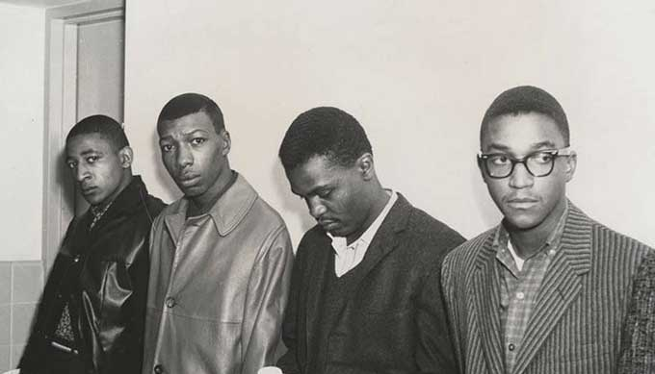
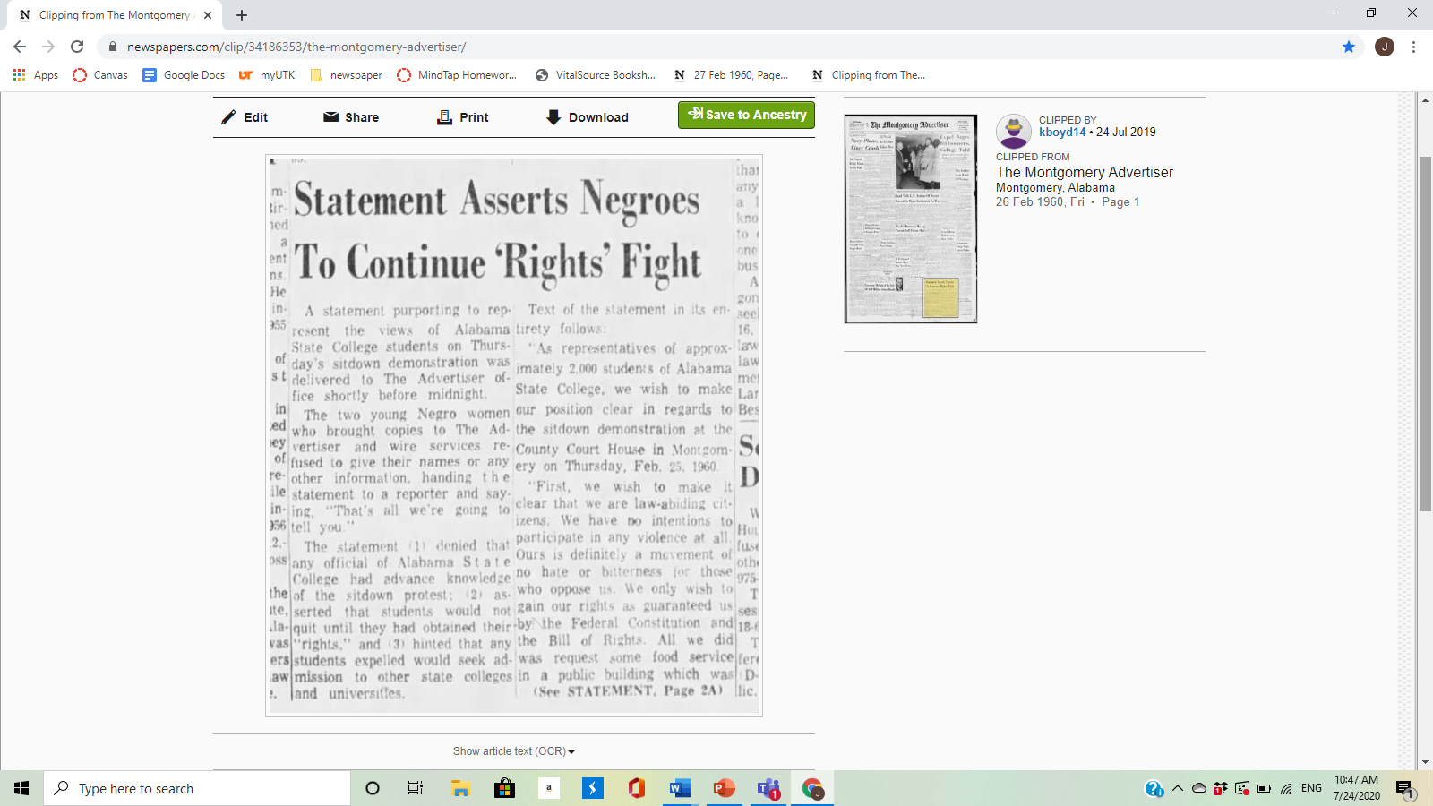
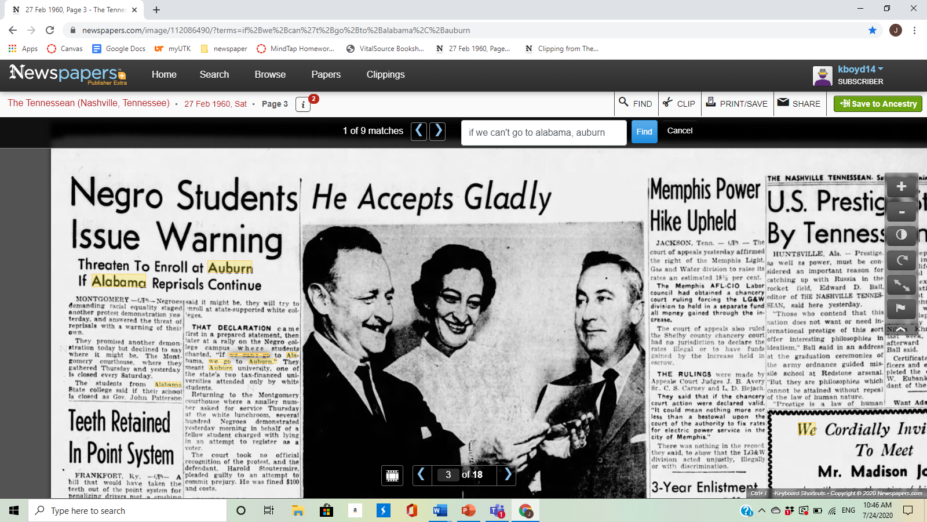

Slide 6
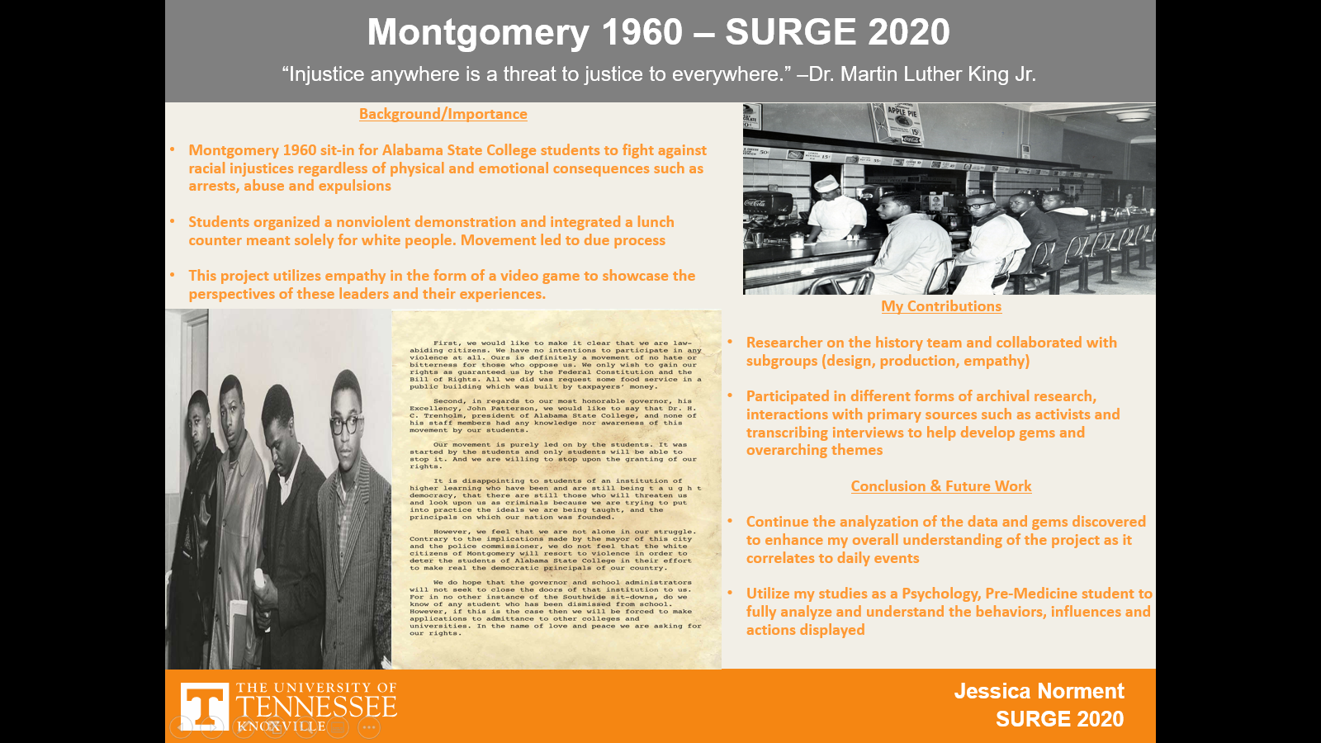

Slide 7

Future Steps
Continue the analyzation of the data and gems discovered to enhance my overall understanding of the project as it correlates to daily events
Utilize my studies as a Psychology, Pre-Medicine student to fully analyze and understand the behaviors, influences and actions displayed

